Slide 1

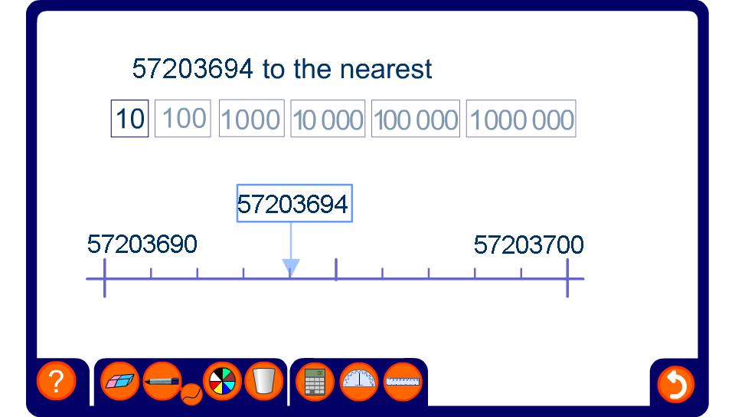


Rounding to powers of ten
Notes:
This activity illustrates the rounding of large whole numbers to the nearest 10, 100, 1000, 10 000, 100 000 or 1 000 000 using a number line.
For each example ask pupils to round the number by deciding which end-point it is closest to.

